Slide 1
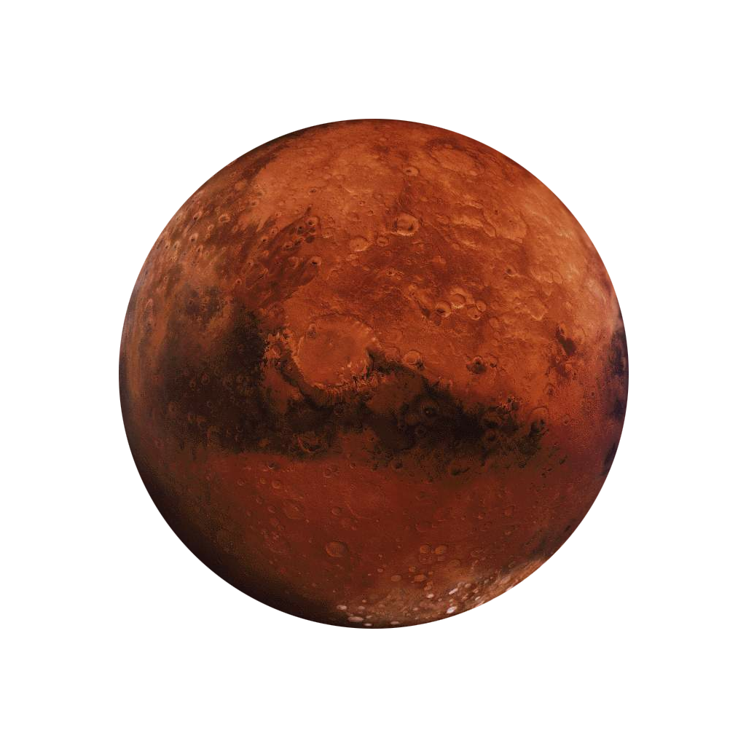
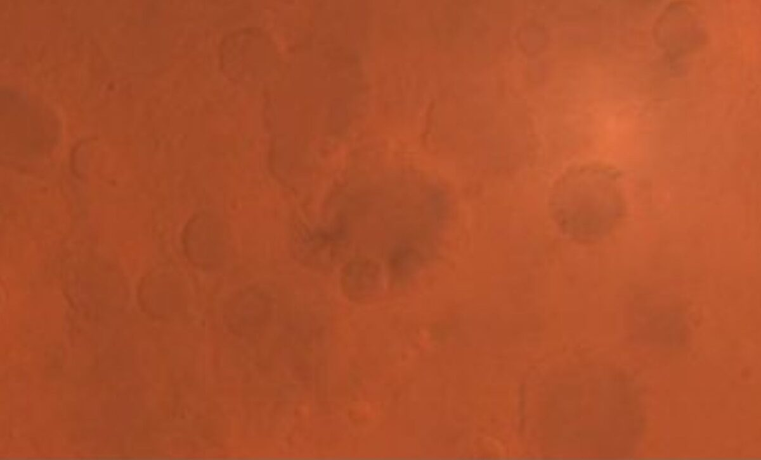




Evaluating Sustainable Agriculture in Extraterrestrial Regolith: The role of AM fungi and Fertilizers
Alexis Bass
Laura Lee, Dr. Nancy Johnson, Northern Arizona University
Arizona NASA Space Grant Consortium Student Research Symposium, Arizona State University
April 19, 2025

Slide 2
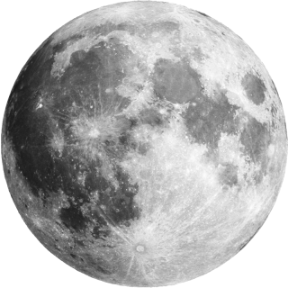
Purpose
Colonization of Mars and the Moon
  What about
    Water?
    Food?
    Waste?
Lighten rocket payloads

Slide 3
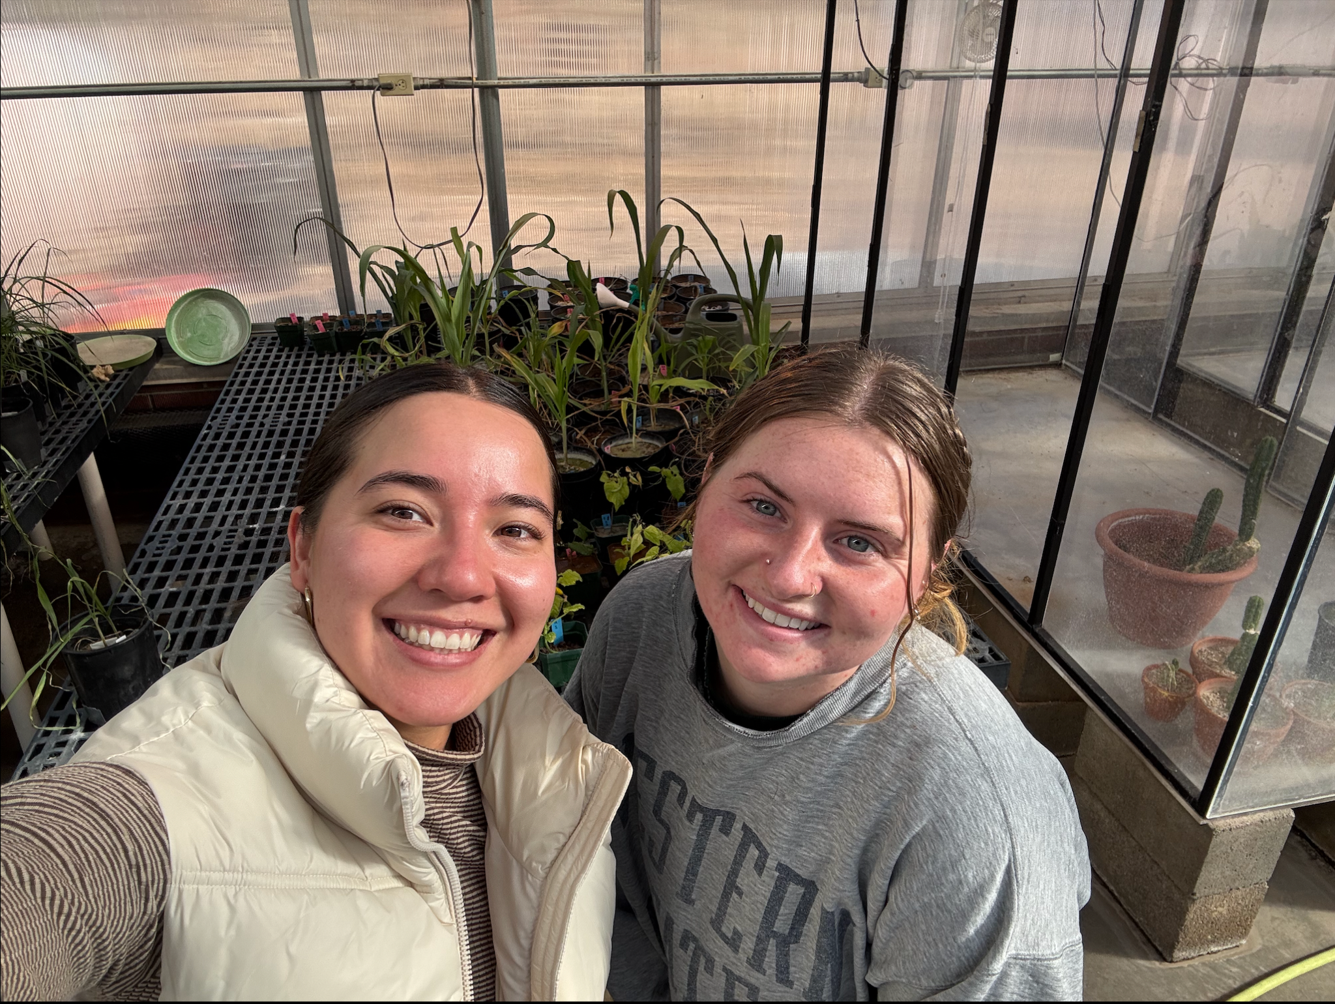
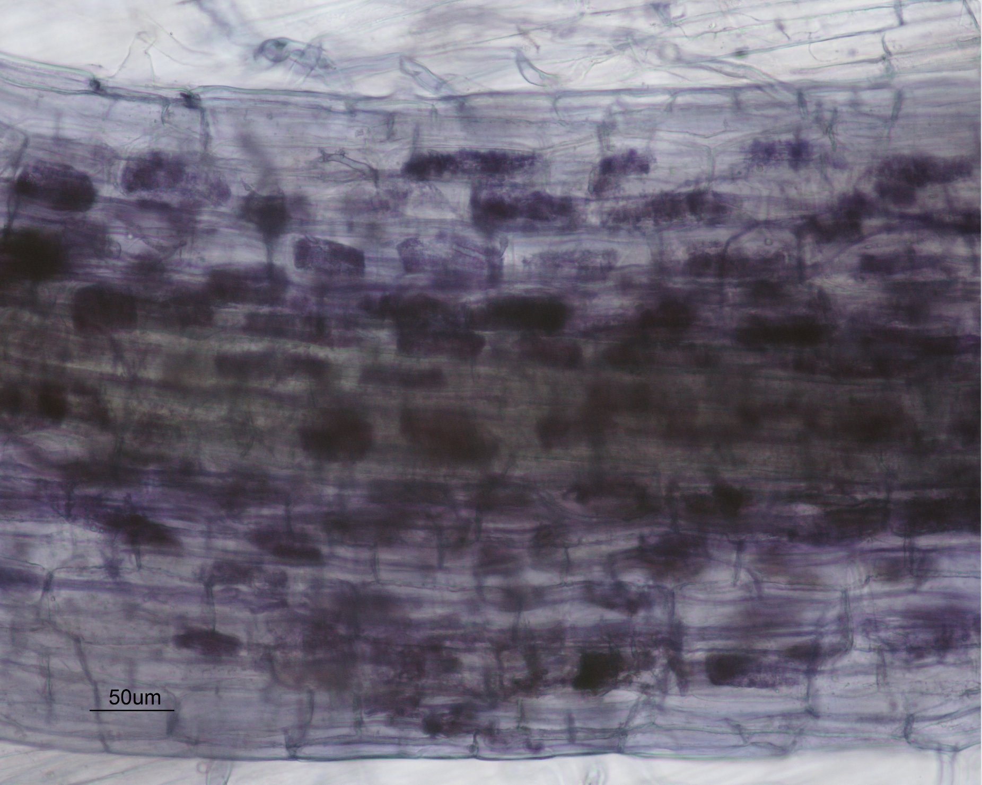
Background
Second round of experimentation
  Laura Lee and Dr. Nancy Johnson
  Plants dislike Mars
Arbuscular Mycorrhizal Fungi
Photo taken by Laura Lee, NAU

Slide 4
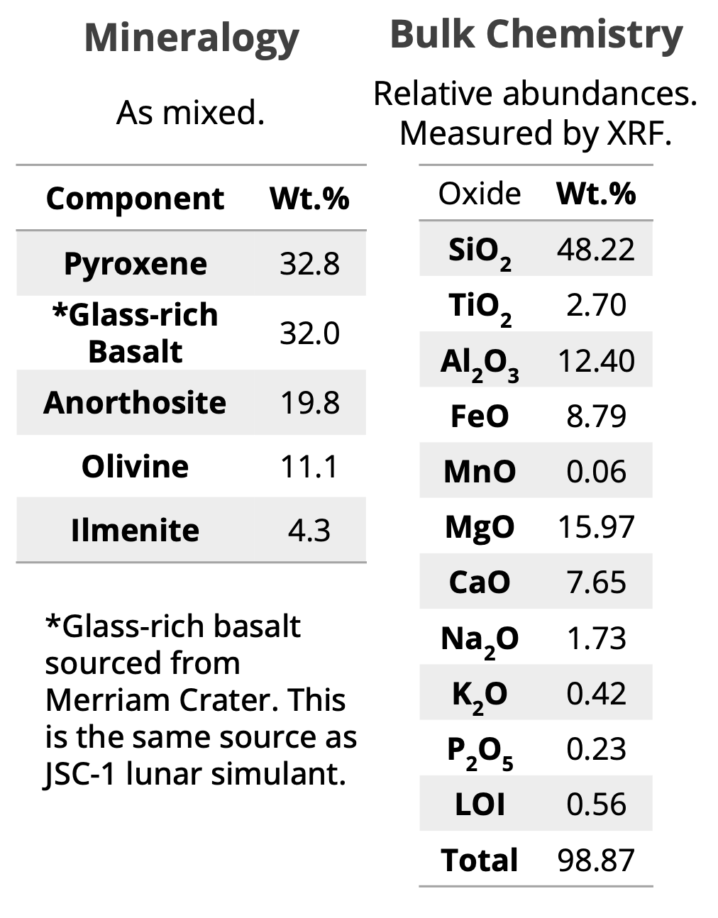
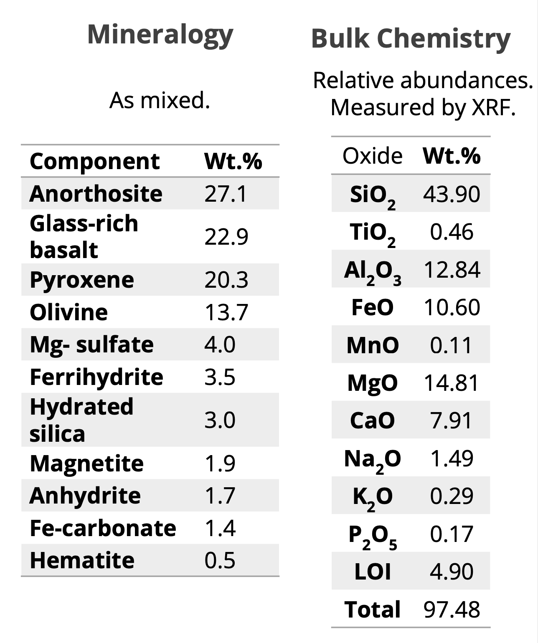
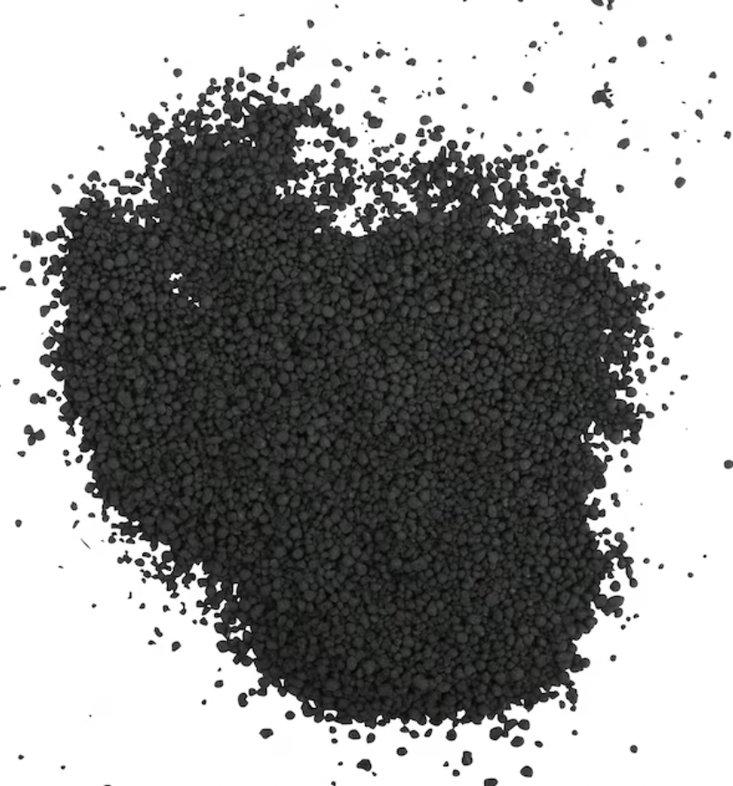
Background
Regolith
Milorganite
  6% N
  4% P
  1.2 % Ca
  2.5% Fe
  1 % Cl
  85% organic matter
Arbuscular Mycorrhizal Fungi
Lunar Composition
Martian Composition
Space Resource Technology
Milorganite

Slide 5
Research Question
Is milorganite an effective fertilizer for Martian and Lunar simulated regolith and does arbuscular mycorrhizae fungi (AMF) aid in plant growth?

Slide 6
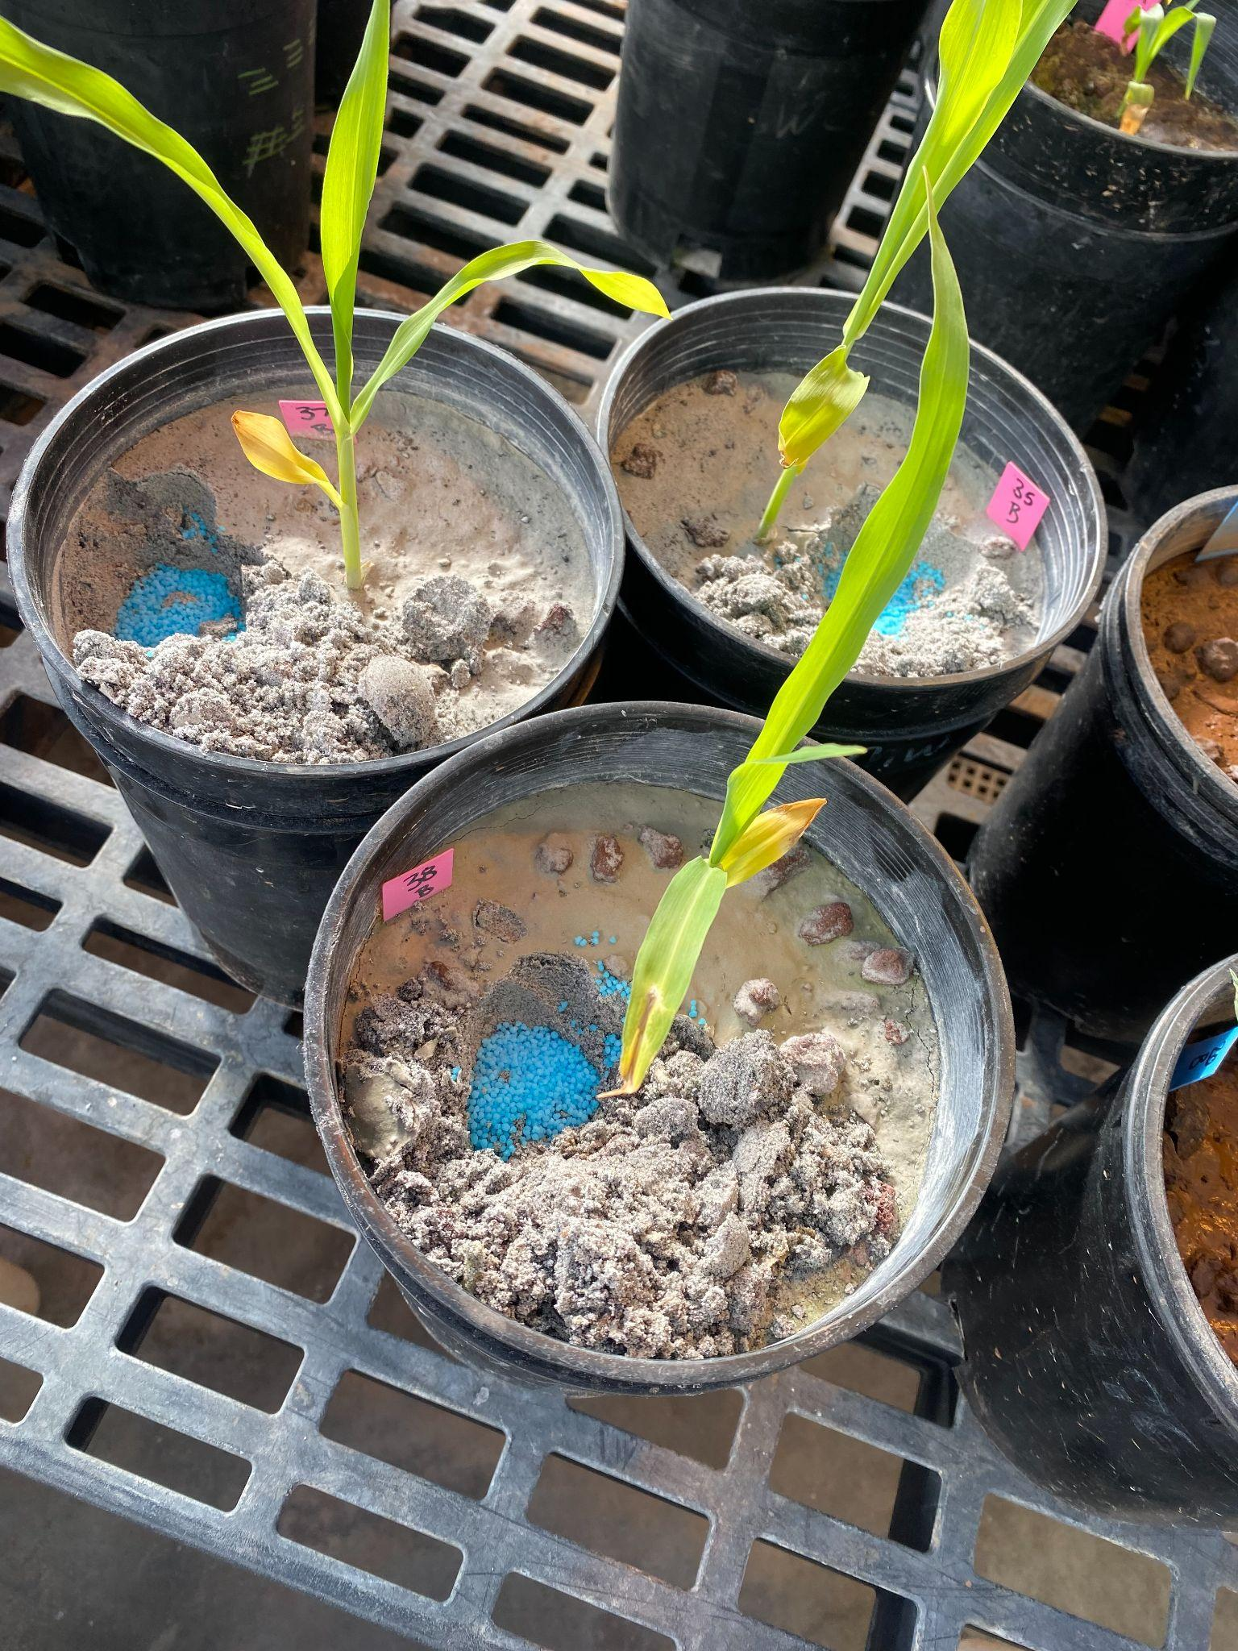
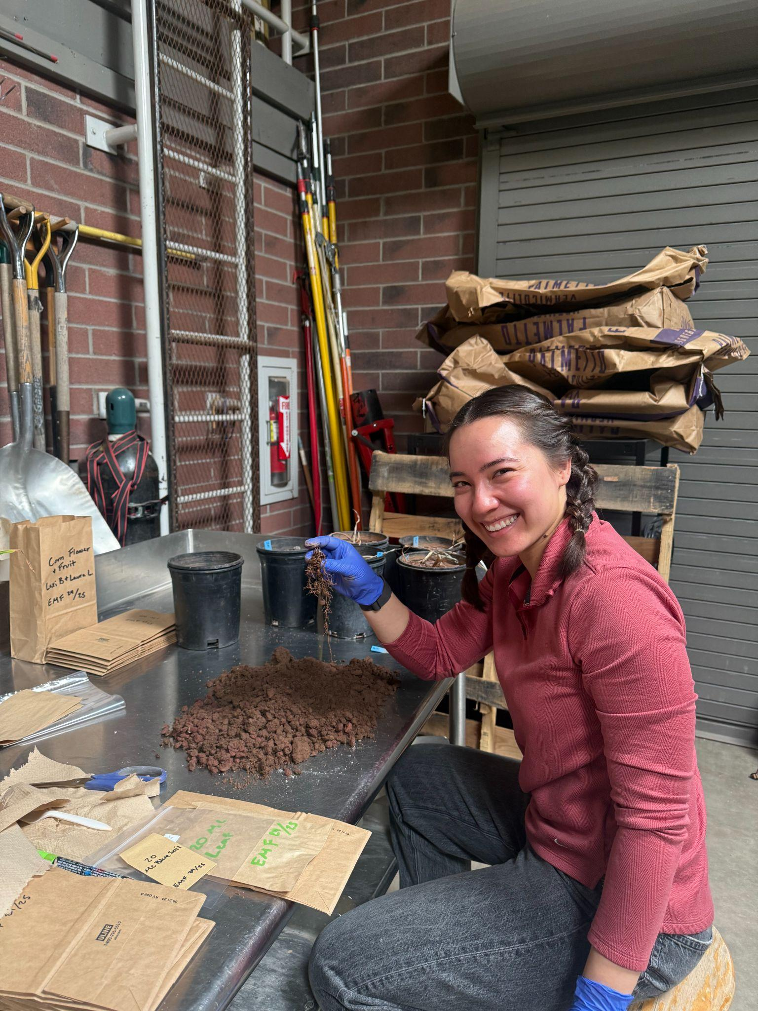
Experimental Design
10/2/24-1/15/25
44 gallon pots
  Martian Corn= 6 replicates
  Lunar Corn = 5 replicates
Experimental groups
  Live/Sterile AMF, Milorganite, and Blue Chip
Sterilized
Cinders

Slide 7
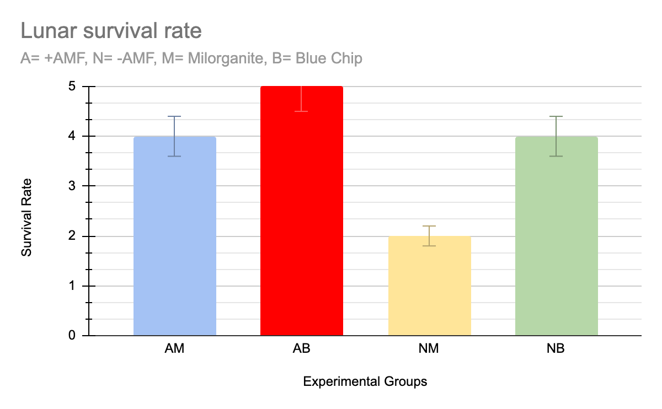
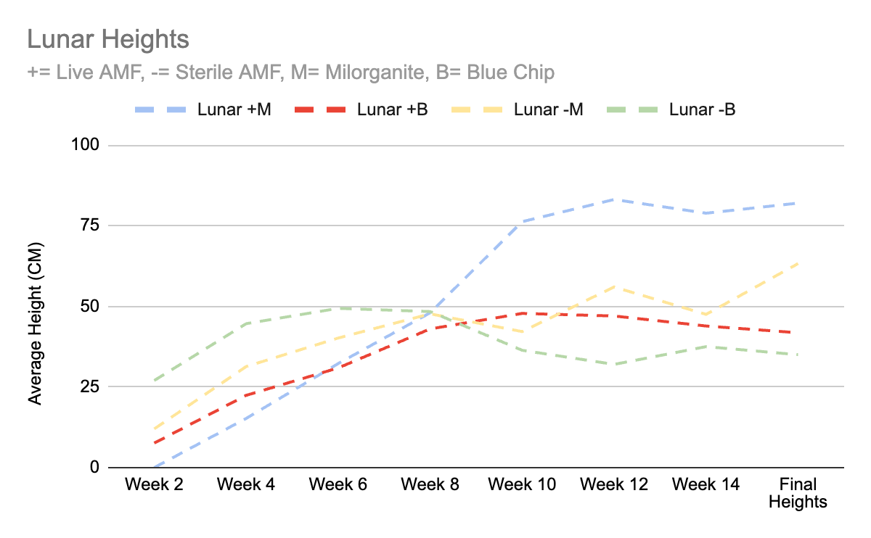
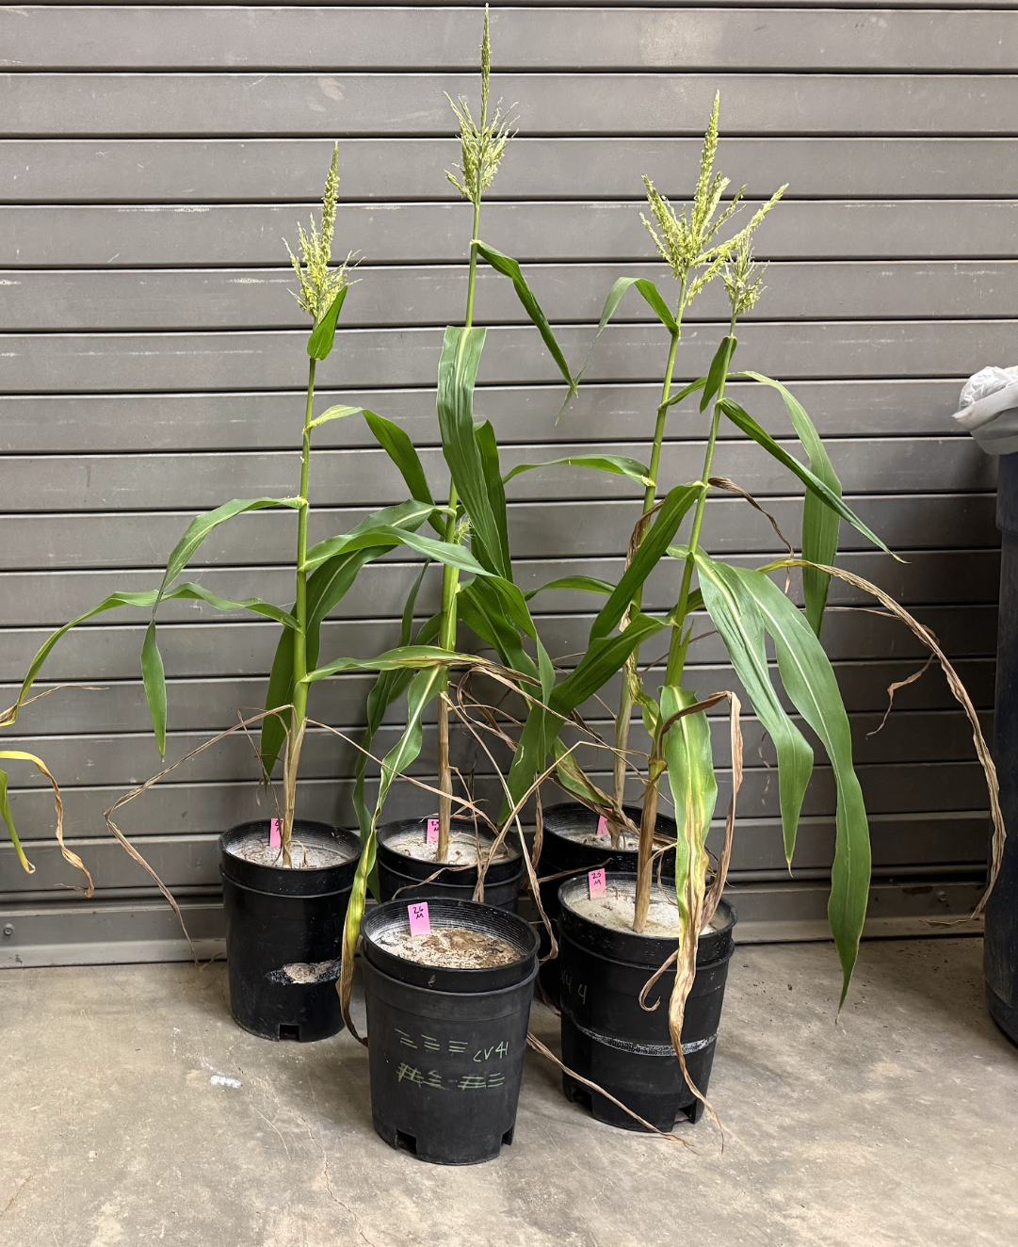
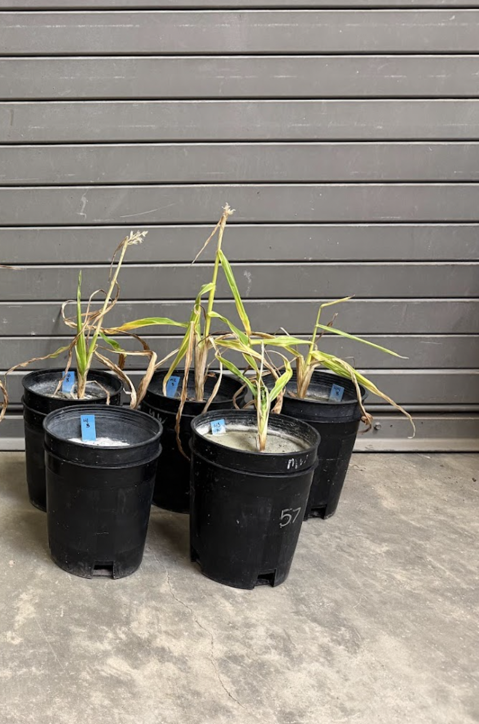
Lunar Corn Results
+=Live AMF, -= Sterile AMF, M= Milorganite, B= Blue Chip
4/5
+B higher survival rate
+M & -B tied in survival rate.
  +M tallest
  -B shortest
+M
+B
-M
-B
+M
-B

Slide 8
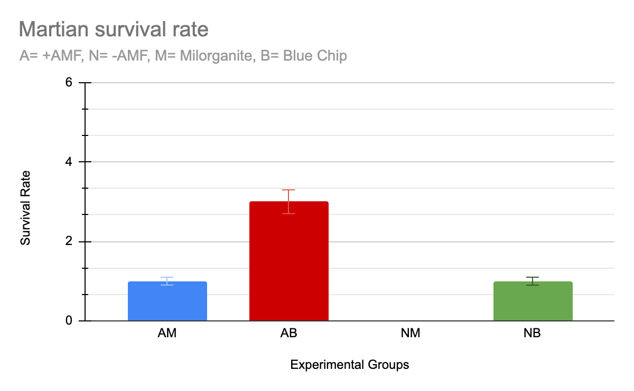
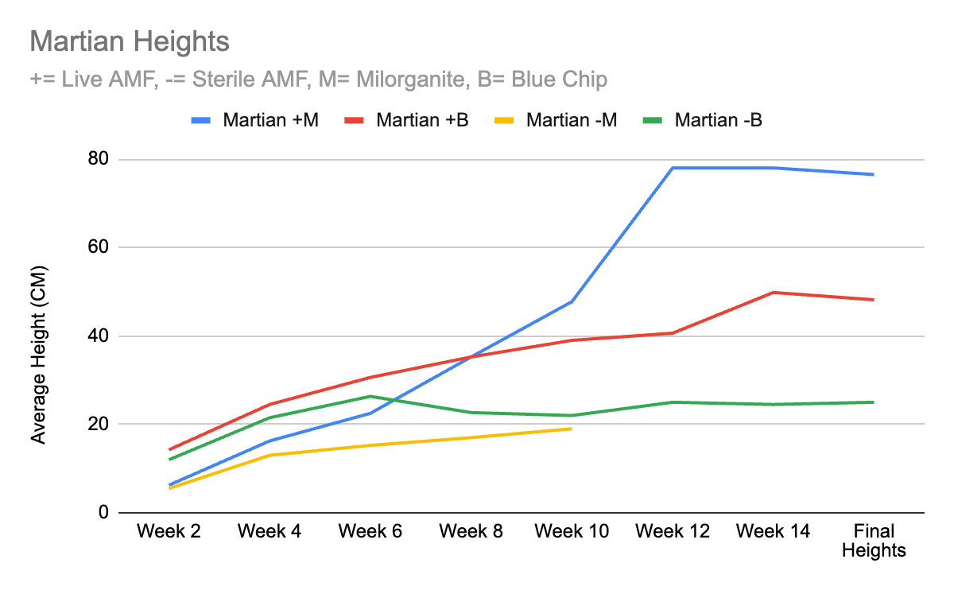
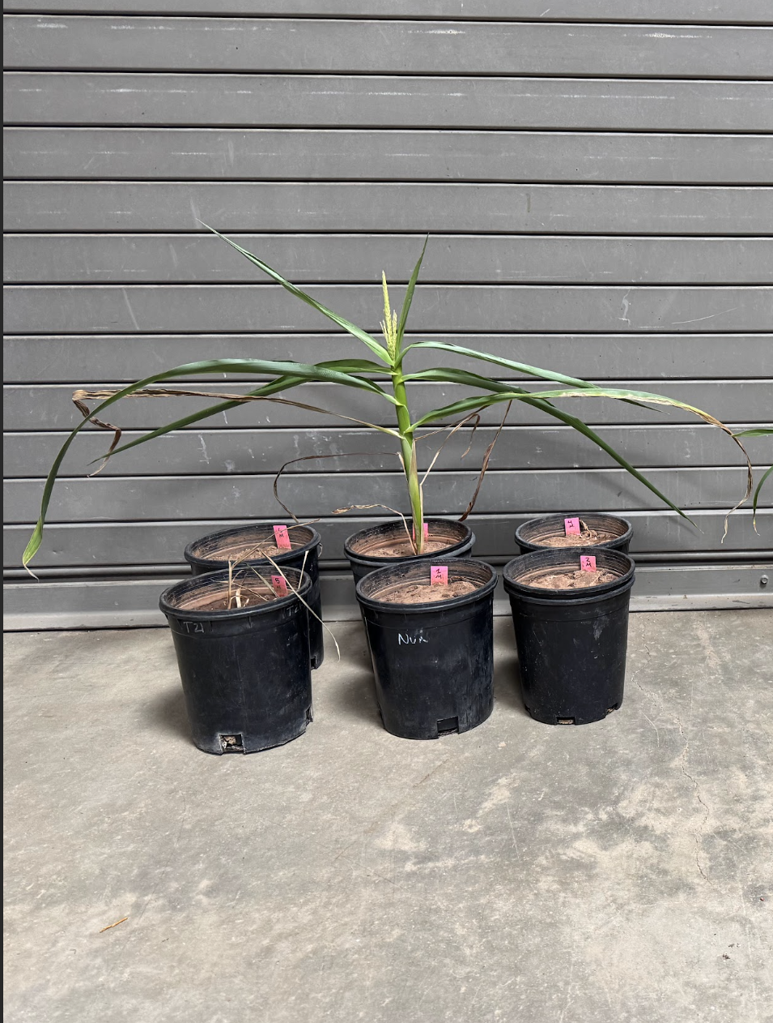
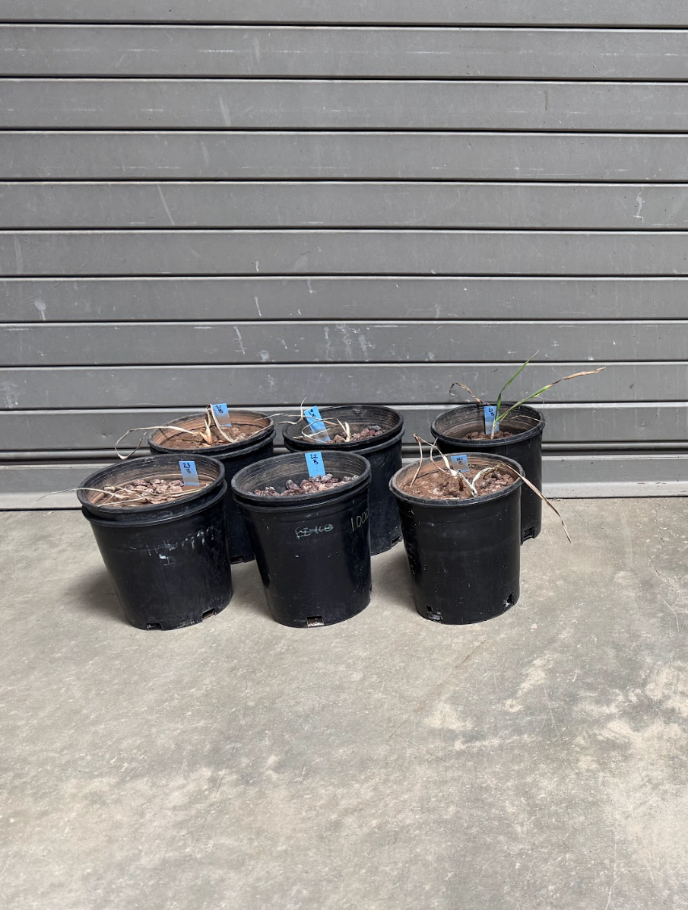
Martian Corn Results
+=Live AMF, -= Sterile AMF, M= Milorganite, B= Blue Chip
1/6
+B highest survival rate
+M & -B tied in survival rate
  +M tallest
+M
+B
-M
-B
+M
-B

Slide 9
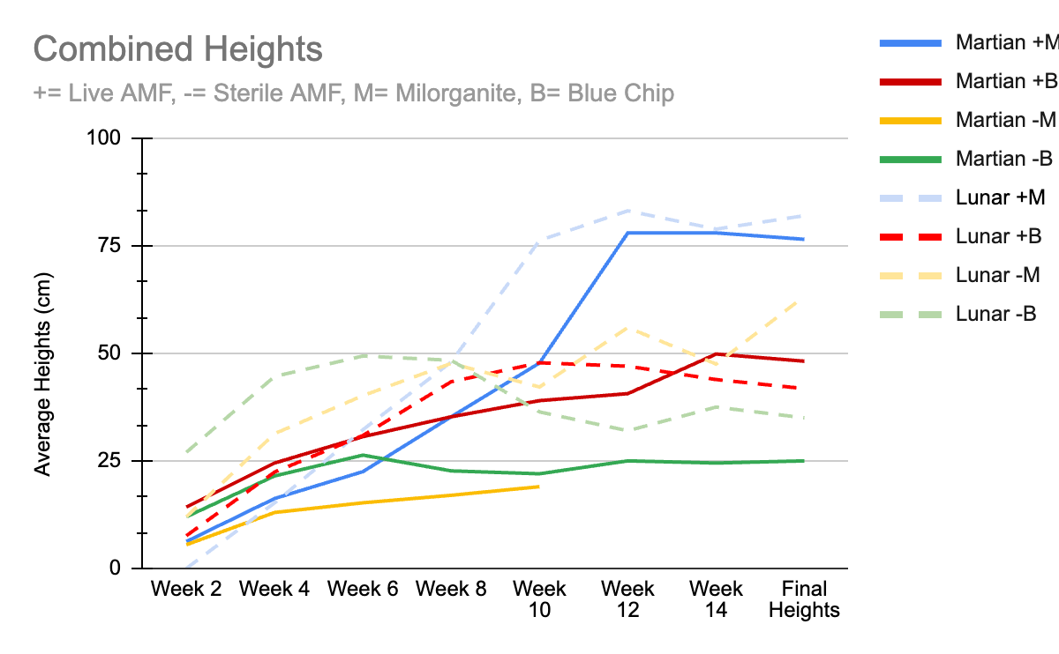
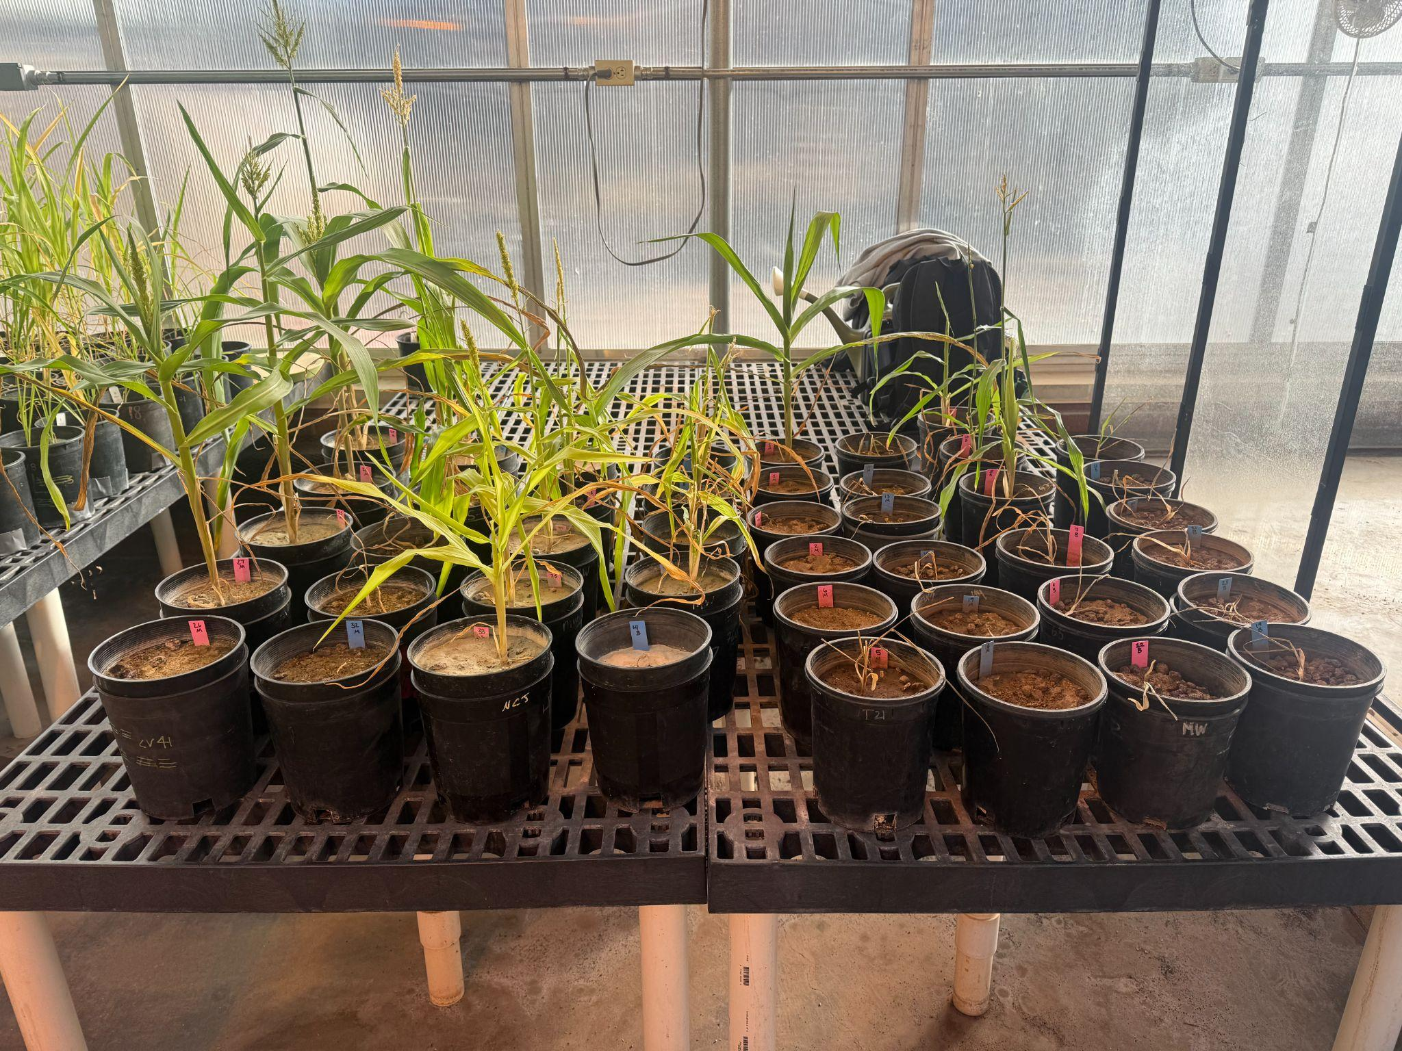
Combined Preliminary Results

Slide 10
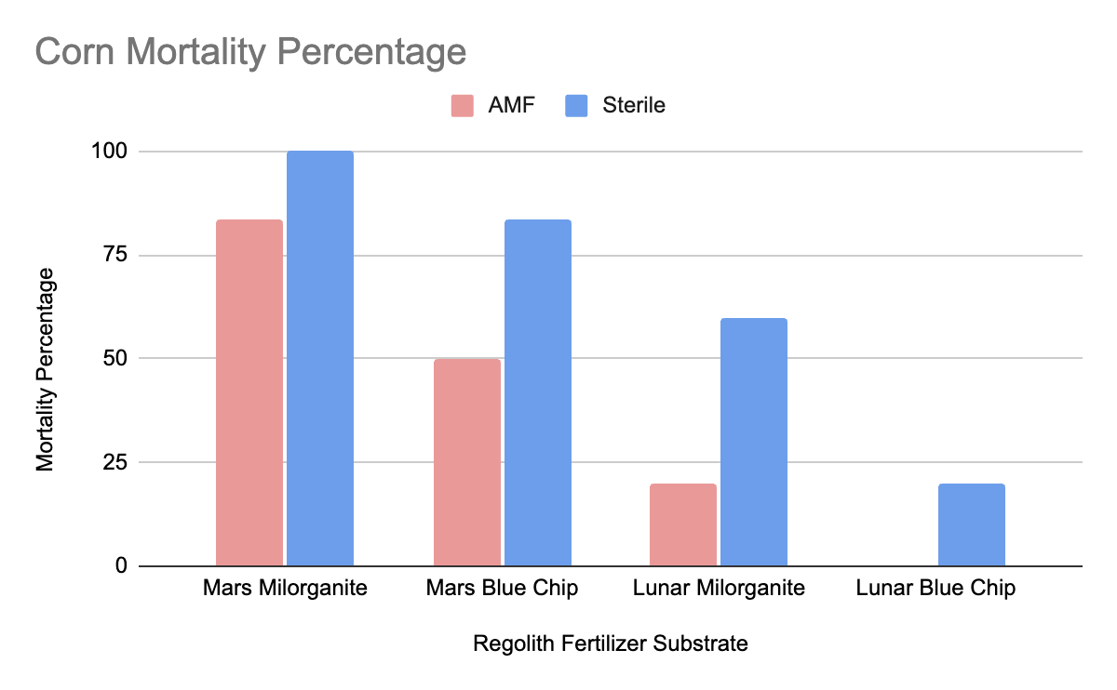
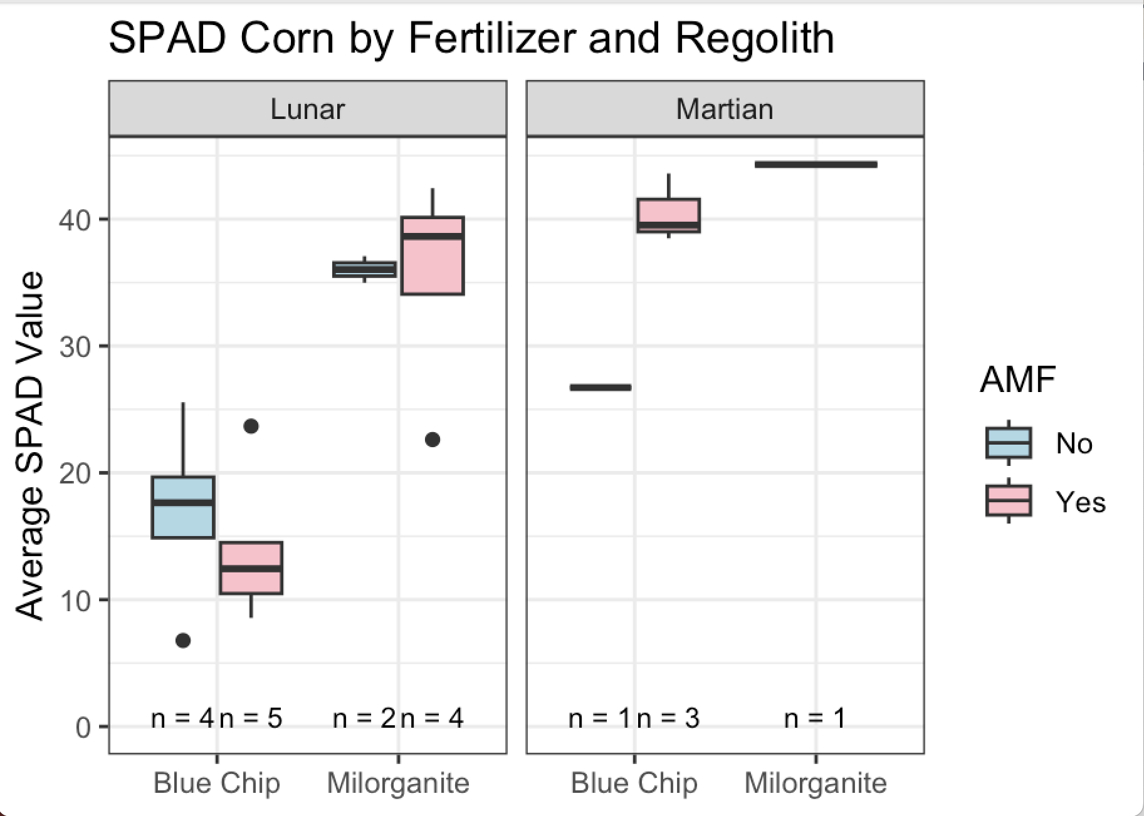
Corn Results
SPAD measures the leaf health of a plant.

Slide 11
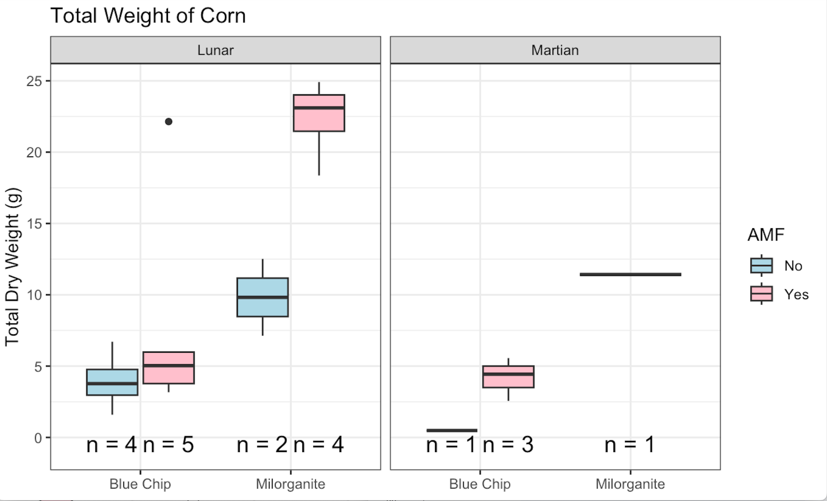
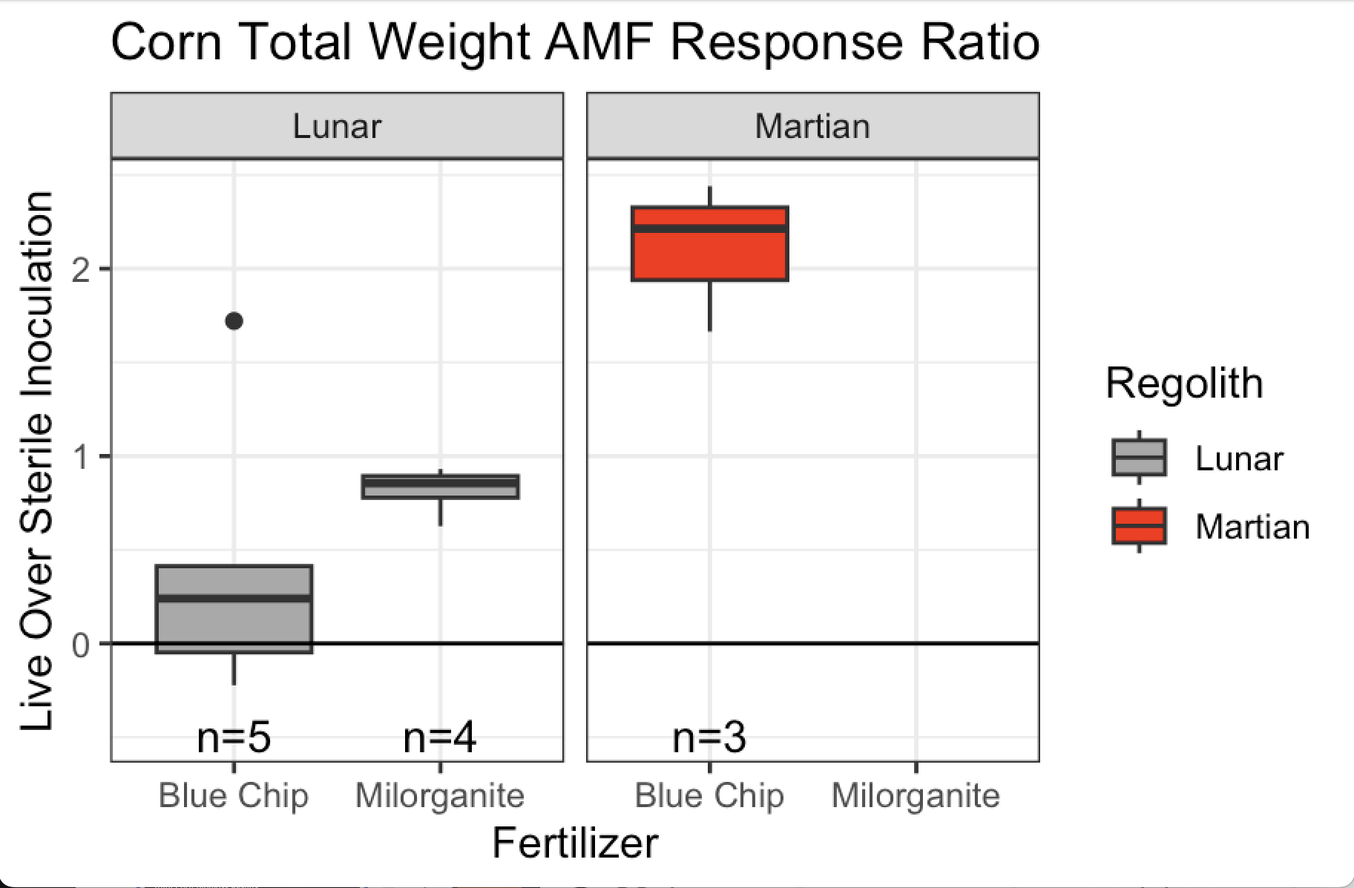
Total Corn Biomass Results

Slide 12
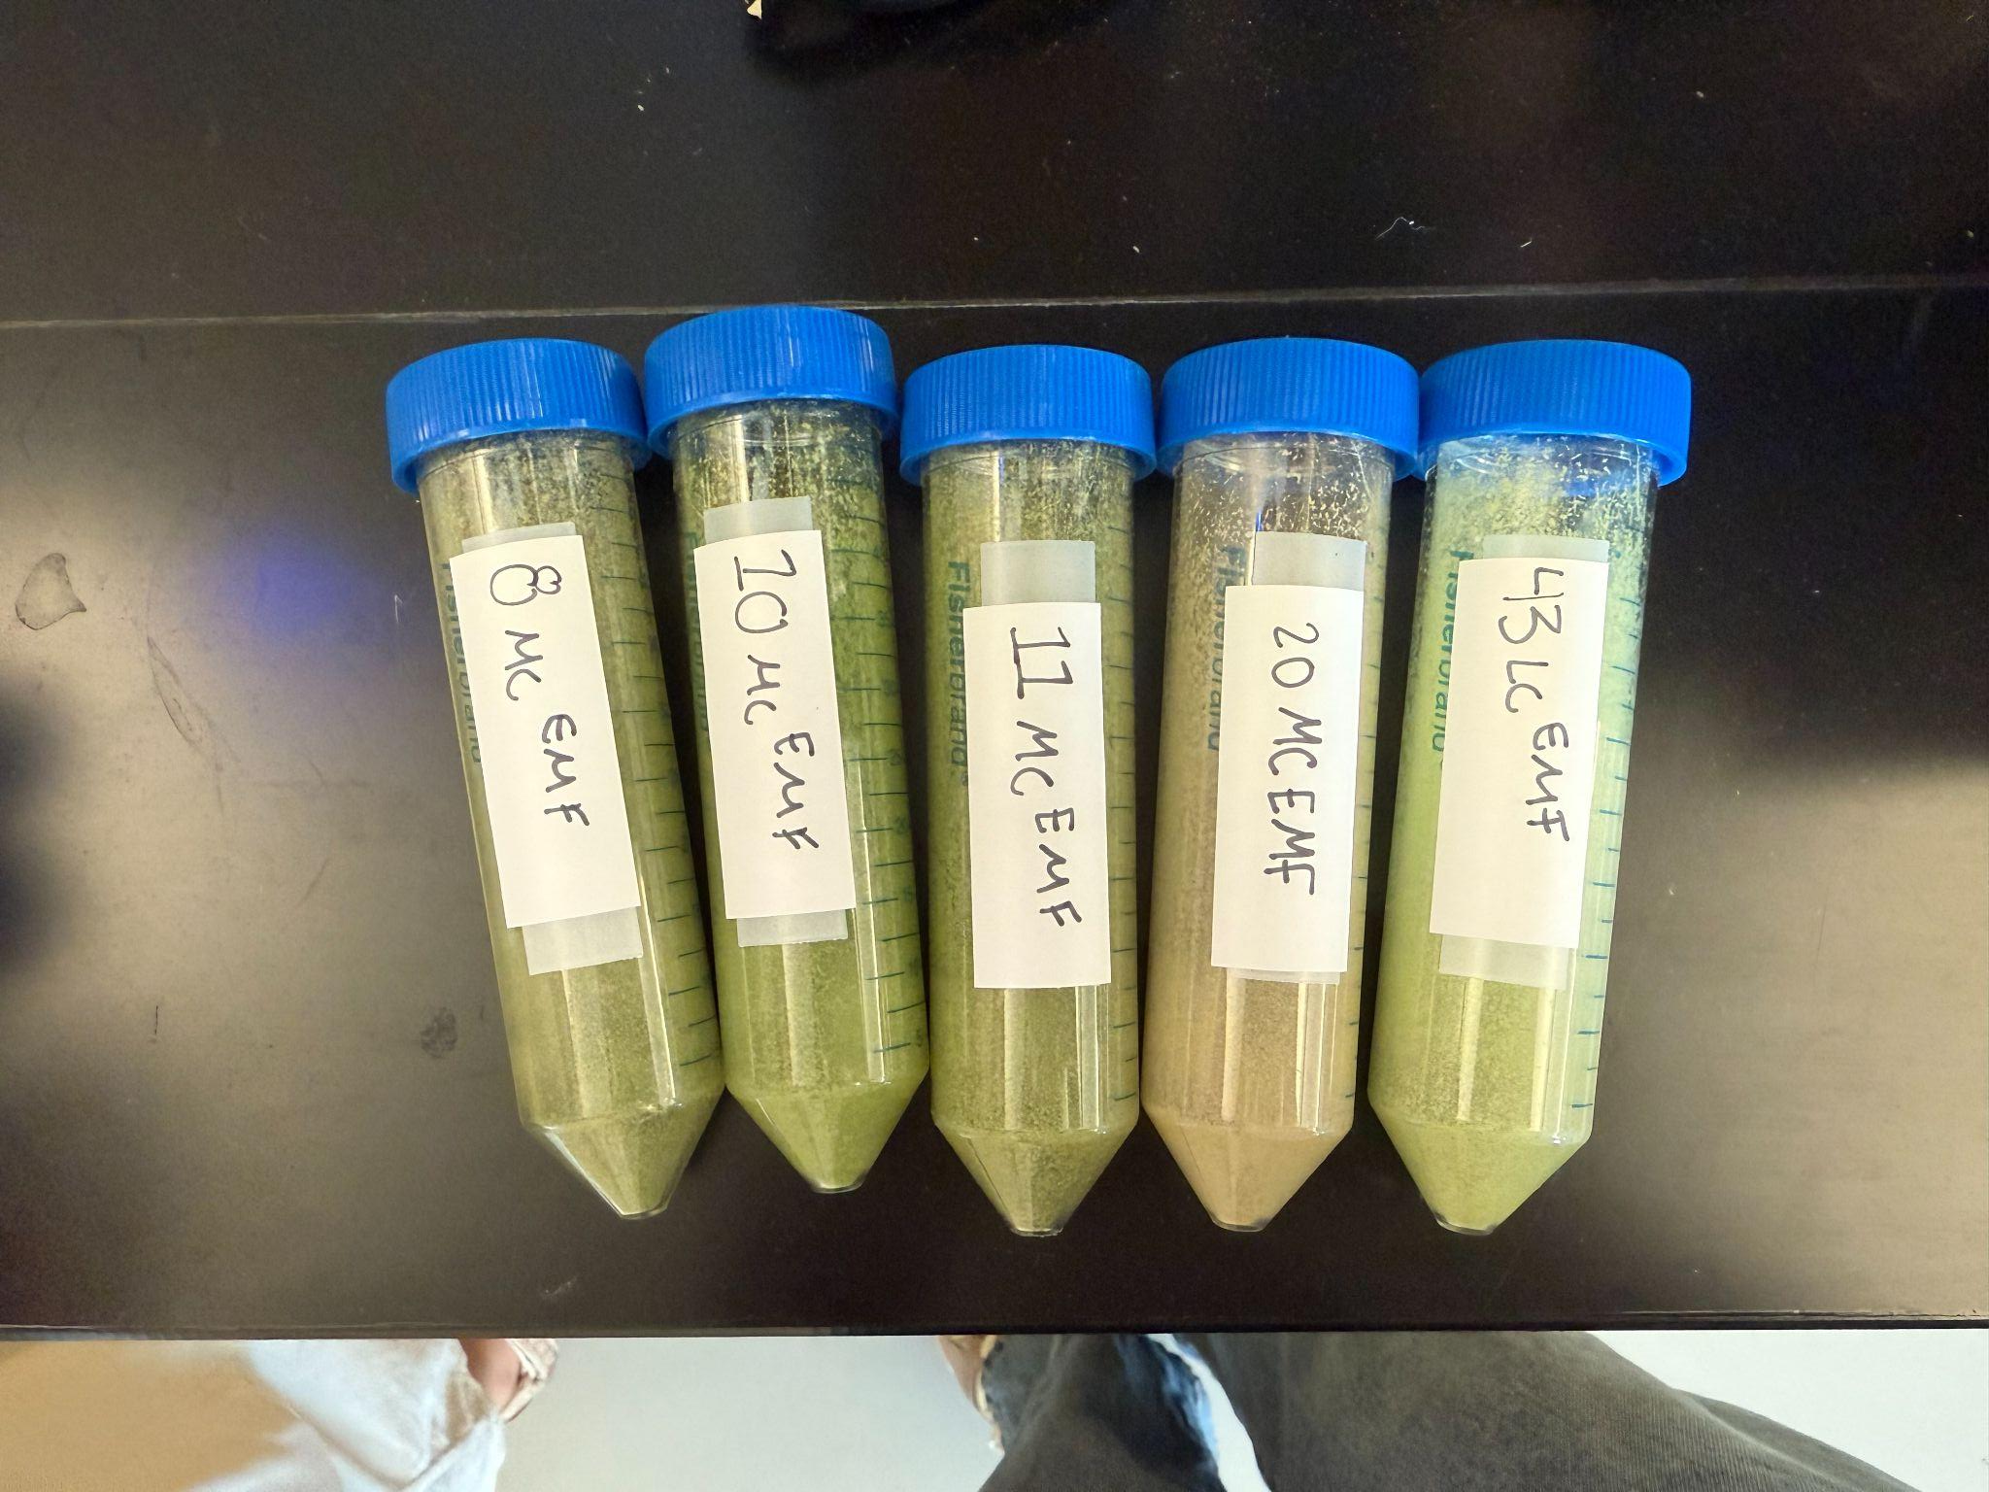
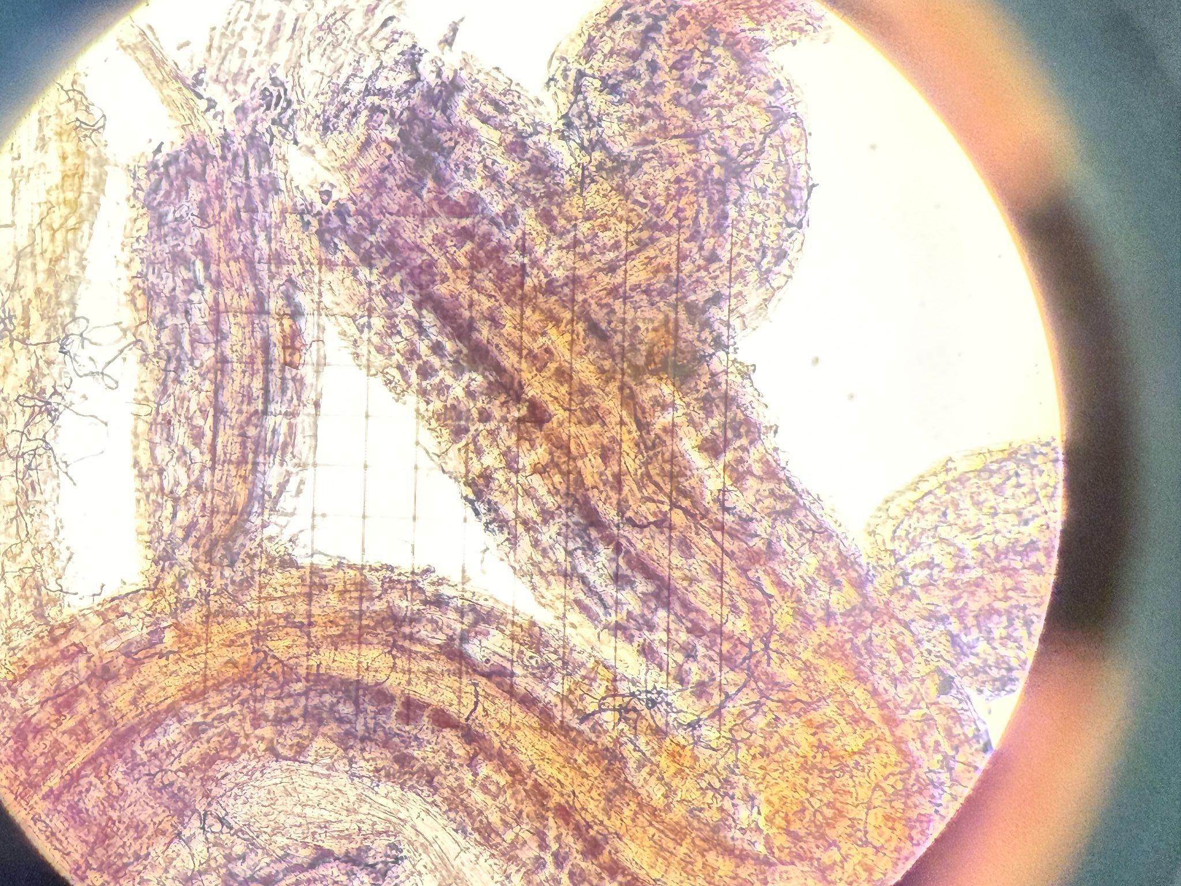
Results
In all surviving pots, corn produced more biomass when grown with AM fungi.
Overall positive shoot growth response to Milorganite compared to Blue Chip among living corn pots.
Sterile AM fungi recipient groups resulted in higher mortality than those that received live AM fungi.
Currently
  Scoring roots
  Nutrient analysis

Slide 13
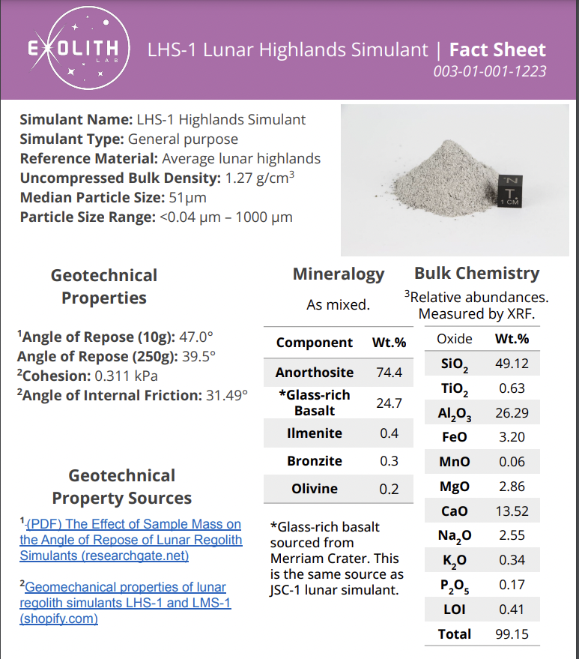
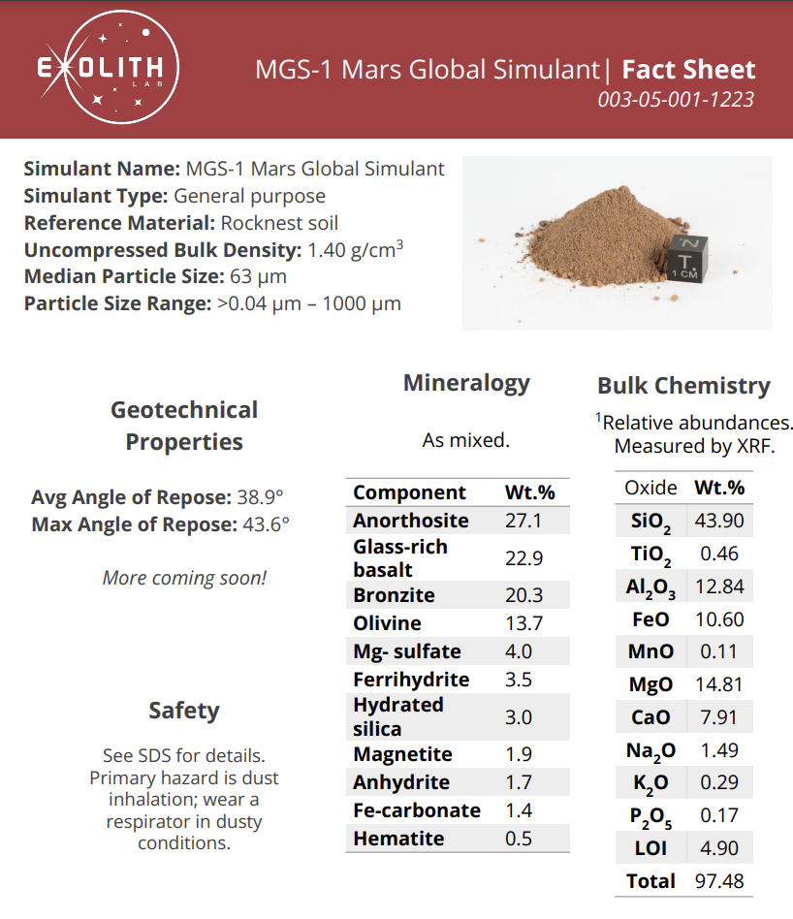
Future Experiments
Figure out why Martian regolith crops grow slower? What is toxic?
Sterile environment
Space Resource Technology

Slide 14

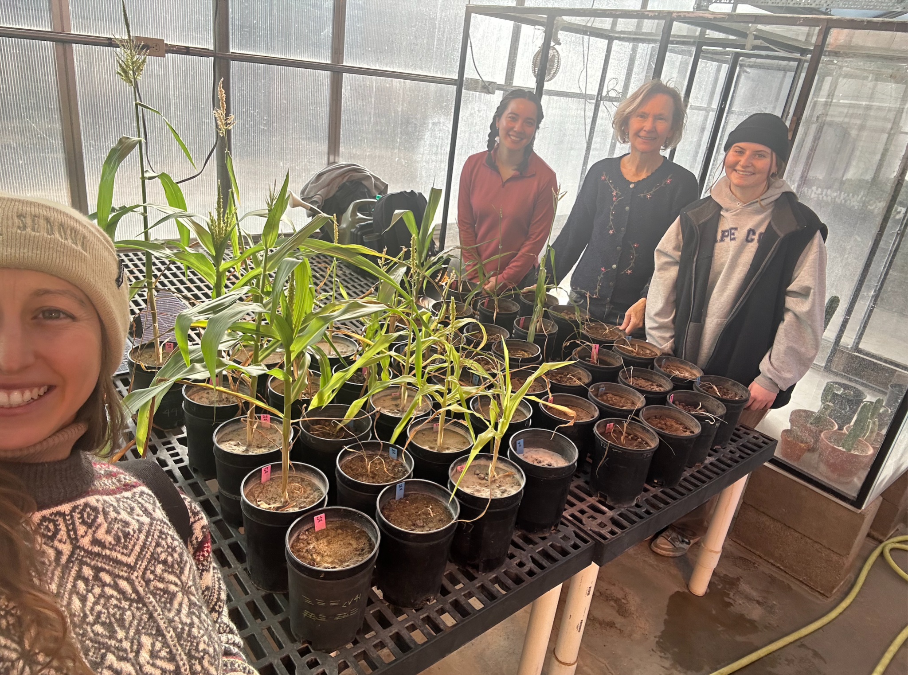
Special Thanks!

Slide 15
Thank You

